Slide 1

NYC Citi Bike Demand Analytics & Prediction Dashboard
A Big Data Exploratory Analysis & Advanced Interactive Dashboard
Master of Science in Data Science — Capstone Project
Live Demo: citibike-capstone-project.vercel.app

Slide 2
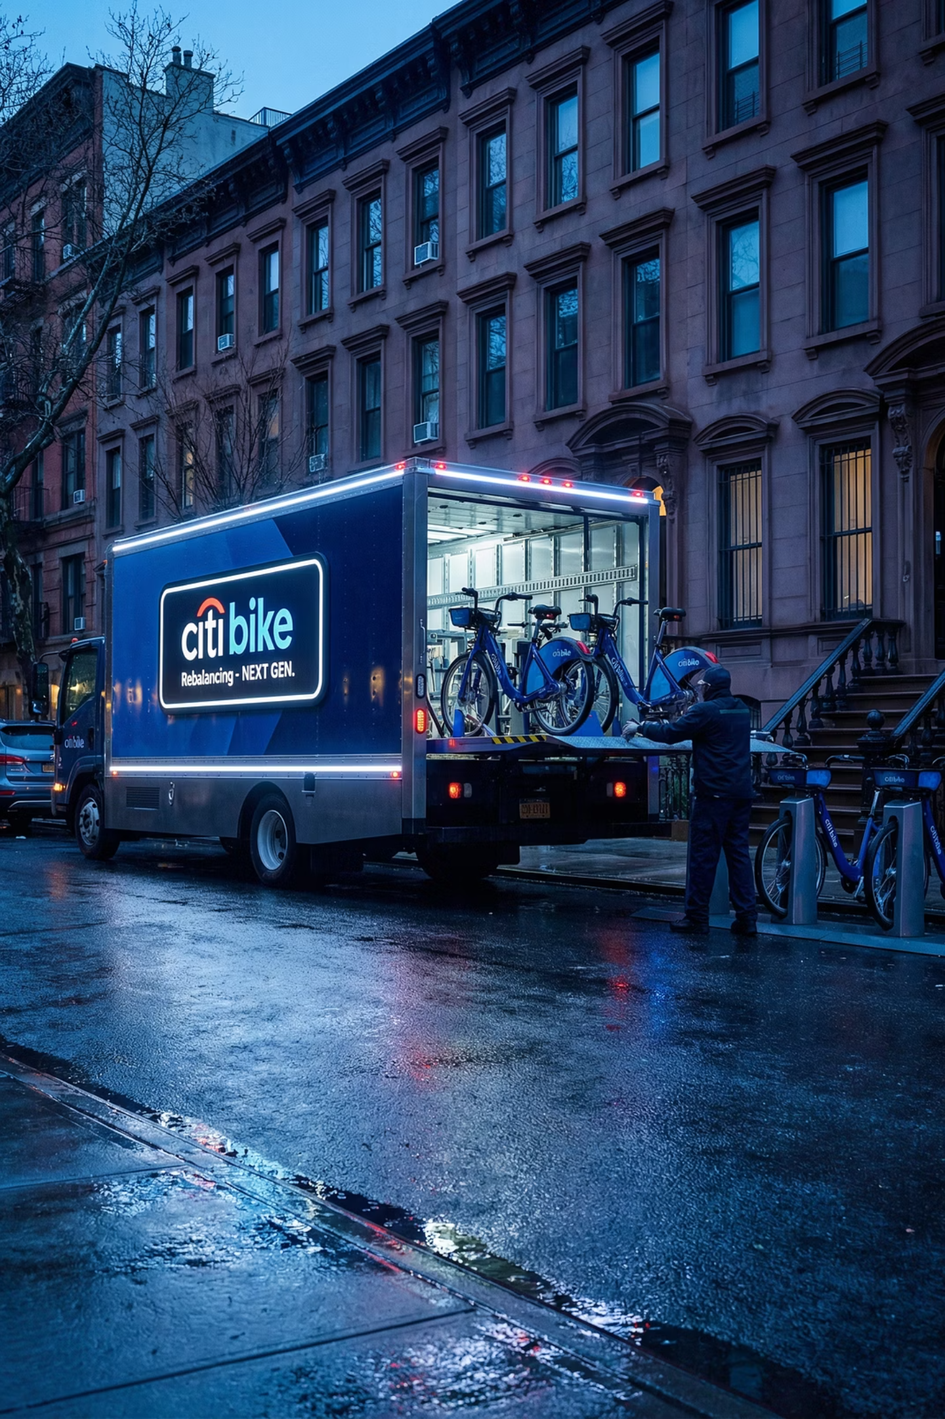
The Challenge: Station Imbalance Crisis
The Problem
Our Solution
NYC Citi Bike operates over 2,500 stations across Manhattan, Brooklyn, Queens, and the Bronx—making it the largest bike-share system in the United States.
Predict hourly bike demand 48 hours in advance to enable proactive fleet management and optimize station availability.
By forecasting demand patterns, operations teams can strategically reposition bikes before imbalances occur, reducing costs and improving user experience.
Stations frequently become empty or completely full, causing user frustration and lost revenue. Current rebalancing relies on truck fleets physically moving bikes between stations, which is expensive and reactive.

Slide 3







Data Foundation: 180 Million Trips
Primary Dataset
Secondary Dataset
180 million Citi Bike trip records from January 2020 to November 2025, covering six years of ridership patterns across all stations.
Daily weather observations from Meteostat API, including temperature, precipitation, and humidity from Central Park weather station.
Data Processing
Removed incomplete records, filtered anomalous trips under one minute or over 24 hours, standardized station names, and applied time-based train/test split to prevent data leakage.

Slide 4
Feature Engineering: 54 Predictive Variables
We engineered a comprehensive feature set across four categories to capture the complex patterns driving bike demand:
1
2
Temporal Features
Weather Features
Hour, day of week, month, weekend indicator, rush hour flag, holiday indicator, and cyclical sine/cosine encodings to preserve circular time relationships.
Temperature, precipitation, humidity, and wind speed measurements that significantly impact ridership behavior.
3
4
Lag Features
Station Features
Demand from 1 hour, 24 hours, and 1 week ago, plus rolling means, rolling standard deviations, and exponential moving averages.
Historical hourly averages, day-of-week patterns, and popularity scores unique to each station location.

Slide 5
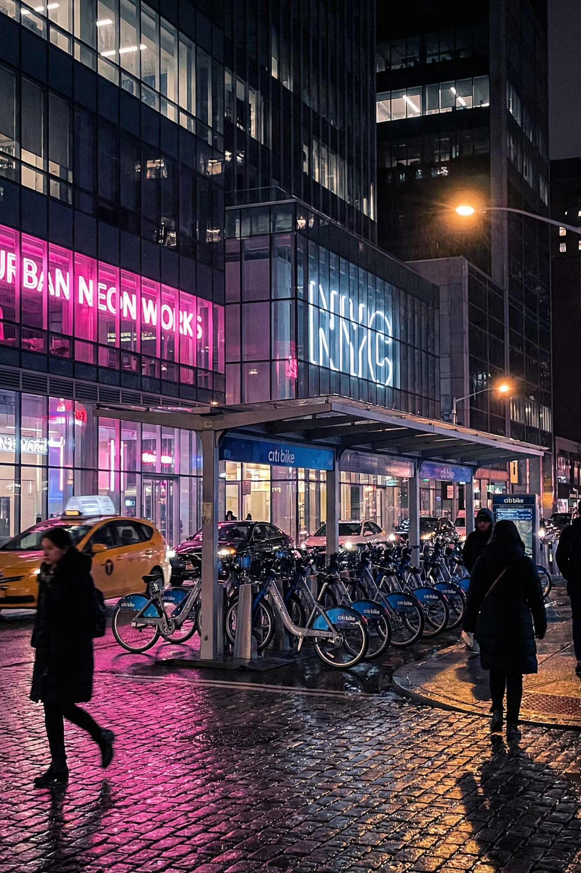



Machine Learning Approach
Training Data
28 million hourly demand records with 5-fold time-series cross-validation
Ensemble Model
Weighted combination of XGBoost, LightGBM, and CatBoost
Optimization
Early stopping after 50 rounds without improvement
Our approach leveraged gradient boosted tree models, which excel at capturing non-linear relationships and complex interactions between features. Each model contributes approximately equal weight to the final ensemble prediction, combining their strengths while mitigating individual weaknesses.

Slide 6
Model Performance: Strong Predictive Power
0.781
2.66
90%
R² Score
Mean Absolute Error
Accuracy Window
Model explains 78.1% of variance in hourly demand
Average prediction error of 2.66 trips per hour
90% of predictions fall within 7 trips of actual demand
Performance Insights
Weekend predictions achieve an impressive R² of 0.812, indicating stronger pattern consistency during leisure periods.
Evening rush hour (5-7 PM) presents the greatest prediction challenge due to high variability in commuter behavior.

Slide 7
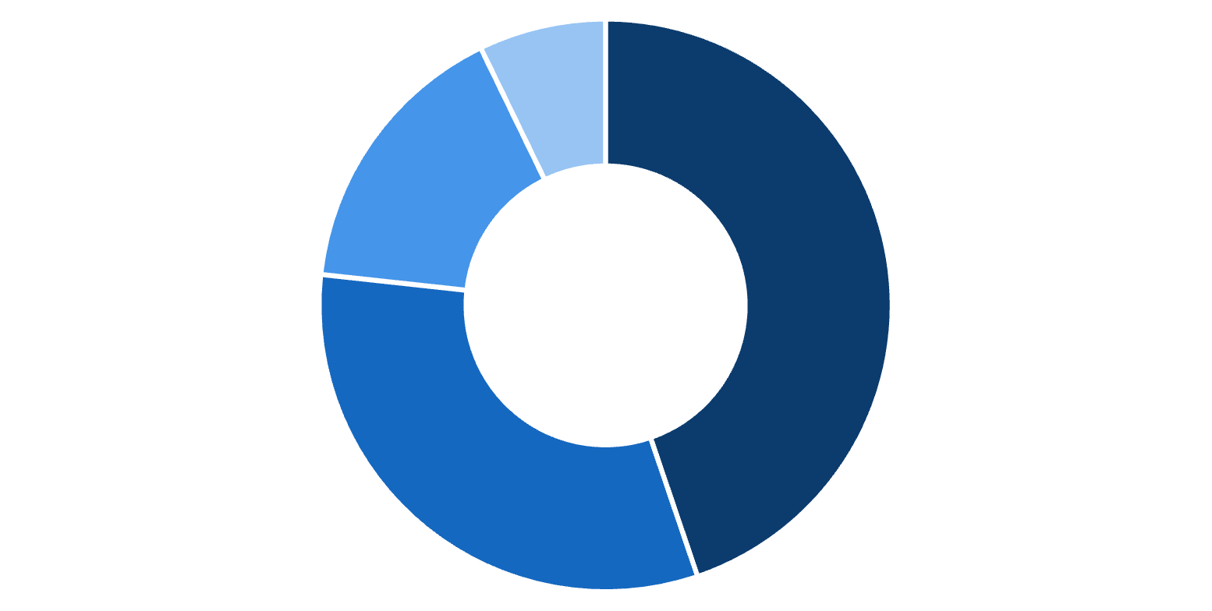
Feature Importance Analysis
Top Predictive Features
Category Contribution
01
Previous hour demand
14.2% contribution
02
Hour of day
9.8% contribution
03
Same hour yesterday
8.7% contribution
Lag Features
Temporal Features
Station Features
Weather Features
Historical demand patterns (lag features) prove most influential, capturing momentum and cyclical behaviors.
04
Rolling 3-hour mean
7.6% contribution
05
Station hourly average
6.8% contribution

Slide 8

System Architecture
Frontend Layer
Prediction Pipeline
React application deployed on Vercel with Deck.gl for 3D map visualizations, Recharts for interactive graphs, and Tailwind CSS for responsive styling.
User selects station and date, backend generates 54 features, ensemble models produce predictions, calibration adjusts for station variance, results returned as JSON.
1
2
3
Backend Layer
FastAPI server deployed on AWS EC2 with 17 REST endpoints, real-time feature generation, and lazy model loading for memory optimization.

Slide 9
Dashboard Features: Six Analytical Views
System Overview
Map Explorer
Neural Demand Lab
Route Analysis
Key performance indicators, time series analysis, anomaly detection, and weather correlation overlays.
3D geospatial visualization with heatmap, hexagon, and point modes, plus real-time live data integration.
48-hour demand prediction generator with historical comparison charts.
Arc flow visualization of top traffic routes between stations.
Station Drilldown
Advanced Analytics
Individual station profiles with hourly demand patterns and detailed metrics.
Experimental simulations including agent-based modeling and digital twin capabilities.

Slide 10

API Documentation: 17 Production Endpoints
Core Analytics
Advanced Features
System overview and statistics
Agent-based simulation
Station listings with metadata
Reinforcement learning policy
Map coordinates for visualization
Station equity scores
Route flows and traffic patterns
Digital twin simulation
Individual station details
Urban heat island data
Prediction Engine
Safety heatmap generation
Synthetic trip generation
48-hour demand forecasting
Incentive systems modeling
Historical demand retrieval
Temporal fusion transformer forecasting

Slide 11




Conclusion and Future Work
Key Achievements
Future Roadmap
Processed 180 million trip records across six years
Real-time Integration
Connect to live station status and occupancy data feeds
Achieved R² of 0.781 with ensemble model
90% prediction accuracy within 7 trips
Weather Forecasts
Incorporate live weather predictions for improved accuracy
Deployed 17 production API endpoints
Model Retraining
Built 6 interactive dashboard views
Build continuous learning pipeline for model updates
Live system: citibike-capstone-project.vercel.app
Mobile Application
Develop field operations app for rebalancing teams

